Slide 1
Hospital Management System
Team Members:
Shaswat Sharma (THA080BCT040)
Raman Shrestha (THA080BCT031)
Biraj Adhikari (THA080BCT013)
Janak Chhatkuli (THA080BCT018)
Department of Electronics and Computer Engineering
Institute of Engineering
Thapathali Campus
April, 2024
Notes:
Hello everyone!
I am …, i am …, i am …, i am … and this is our presentation on our project Hospital Management System

Slide 2
Outline:
INTRODUCTION
MOTIVATION
NEED FOR HMS
OBJECTIVES
METHODOLOGY
RESULT
SCOPE AND APPLICATIONS
FUTURE ENHANCEMENTS
Notes:
So lets look at the general outline of this presentation:

Slide 3
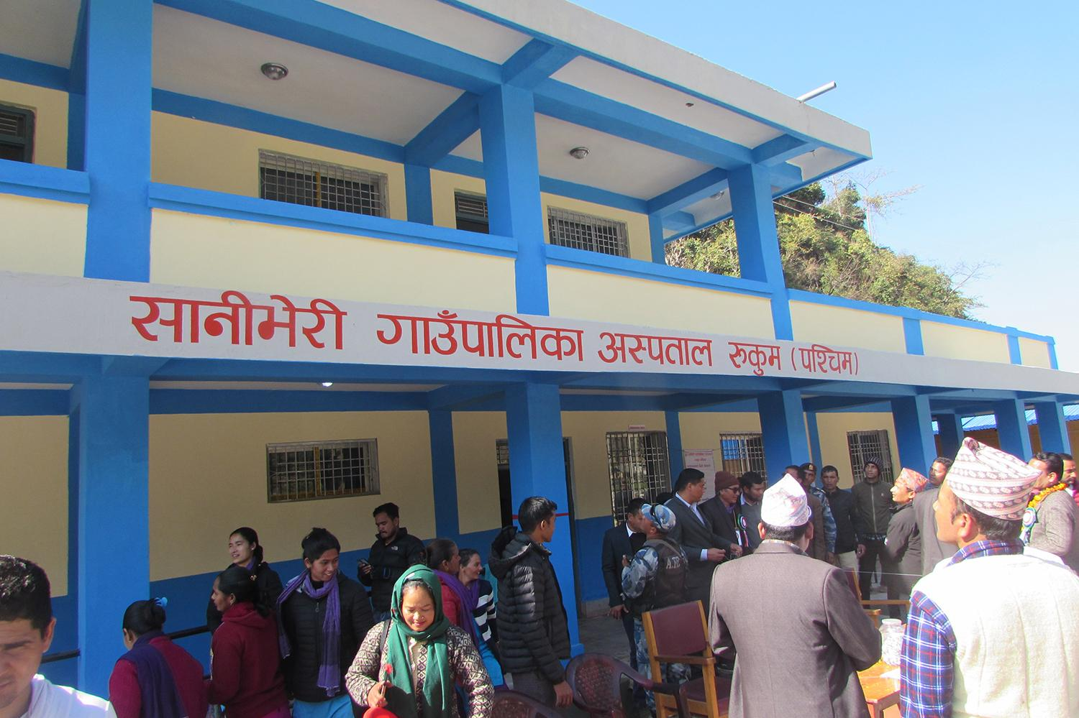
INTRODUCTION
A HMS (Hospital Management System) is a software designed to store, manage and view the records of a patient and their details in an organised and systematic way.
The main use case of HMS will be in the health institutions of rural areas.

Slide 4
MOTIVATION
Sick of searching patient’s information on a handwritten register
To reduce data redundancy
For managing information in efficient way
Use of technology in healthcare industry
Notes:
There has been some sort of misdiagnose or even worse fatalities in almost every peoples household and

Slide 5

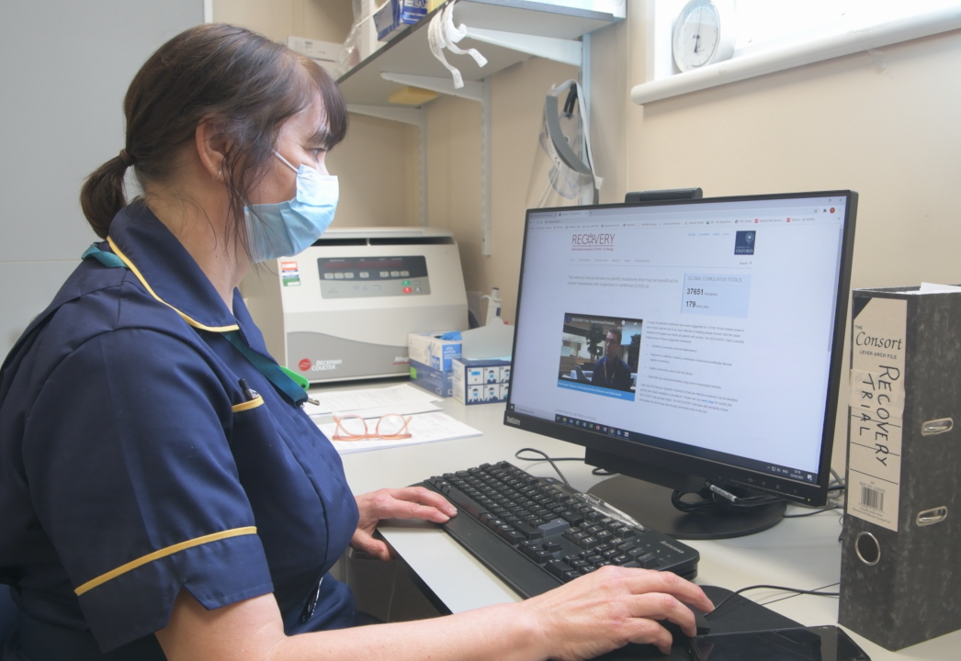
NEED FOR HMS:
There is an extreme need of Hospital Management System in the rural areas of nepal where most of the data storage and retrieval is done through the traditional means of ledgers and registers

Slide 6
OBJECTIVE
PRIMARY OBJECTIVE:
To make the the data handling more easier and convenient in Hospitals and use of C language for fast execution.
SECONDARY OBJECTIVE:
To learn about different features of C: data types, functions, structures, and file handling options to create a cohesive program that serves for the betterment of general public

Slide 7
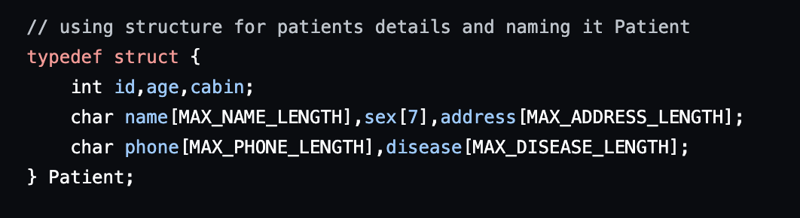
METHODOLOGY
Use of data structures to store the details of the patients in a systematic way

Slide 8
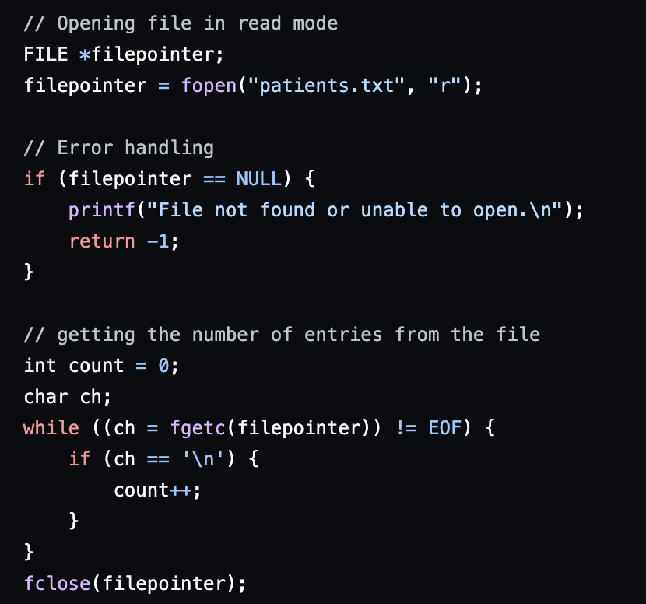
Use of file handling features to store and view all the data in an easily accessible text file

Slide 9
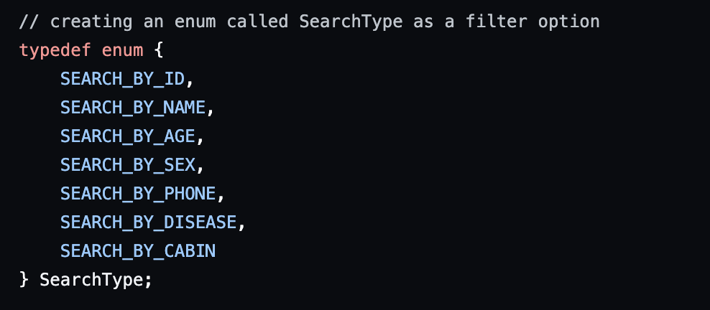
Use of enumerations (enums) for filtering of data

Slide 10
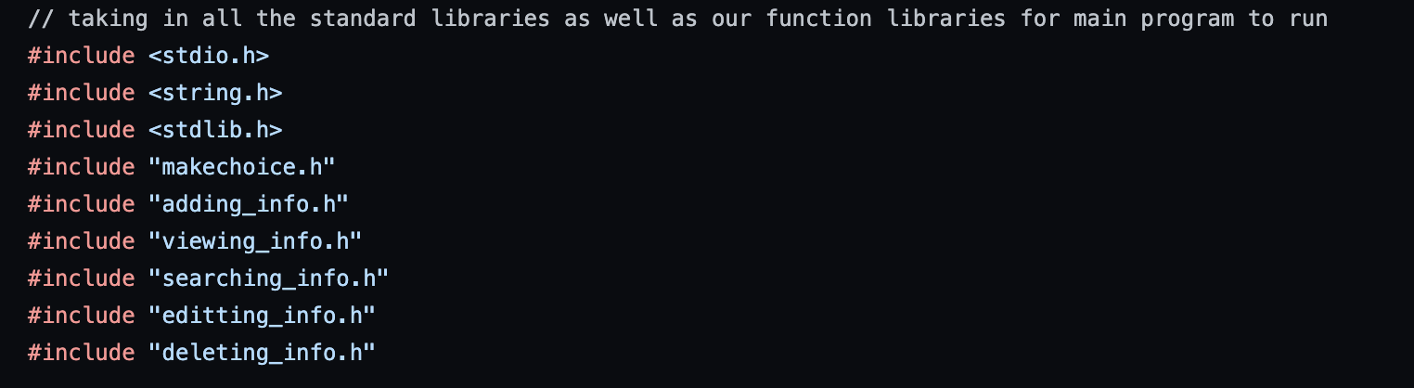
Use of local header files to store the functions

Slide 11
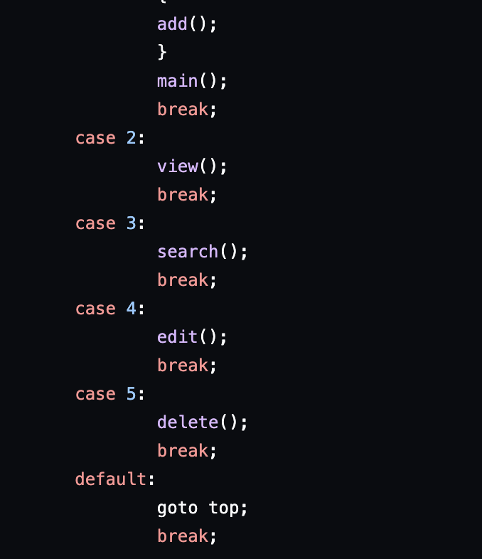
Use of functions for modular programming

Slide 12
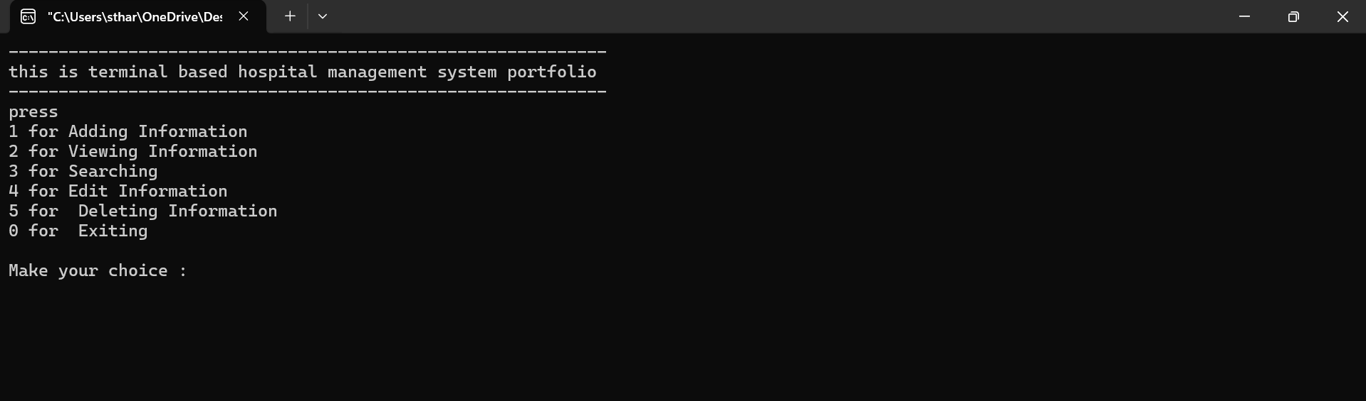
RESULT
For making choices

Slide 13
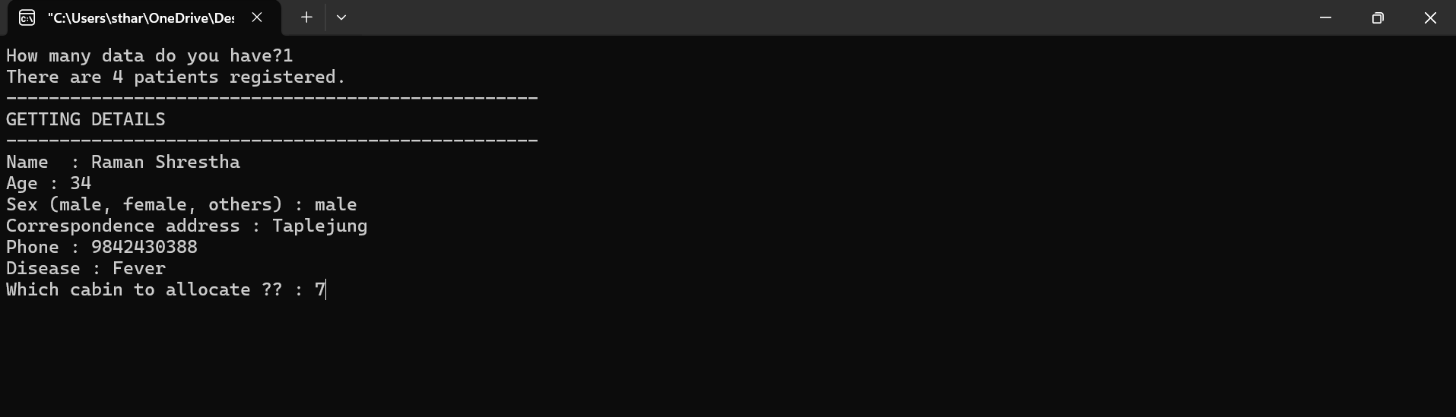
2. For adding information

Slide 14
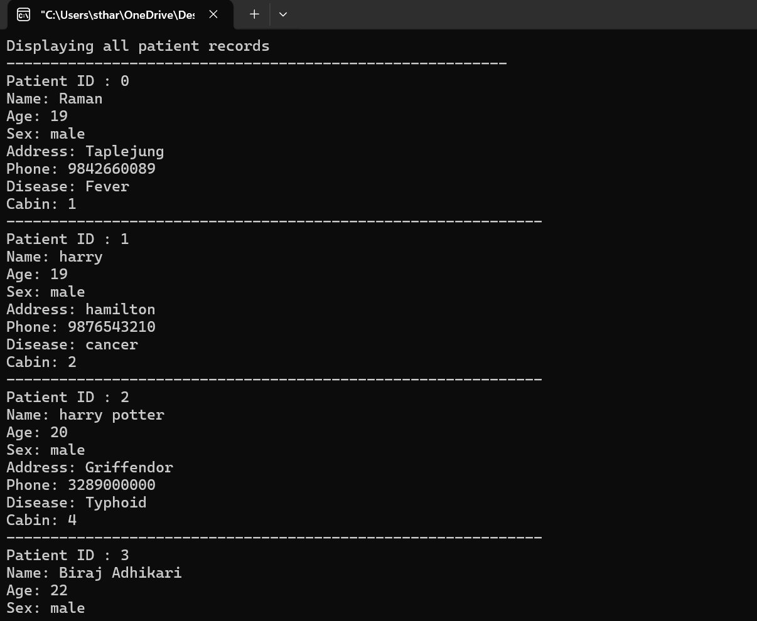
3. For viewing information

Slide 15
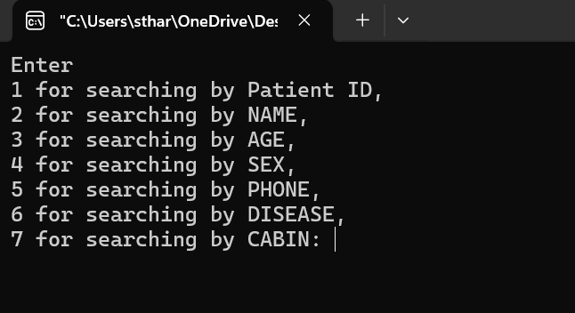
4. For searching Information

Slide 16
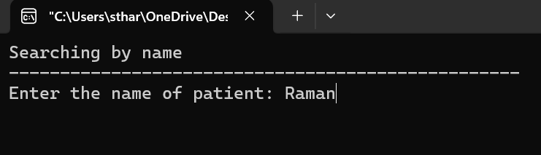

Slide 17
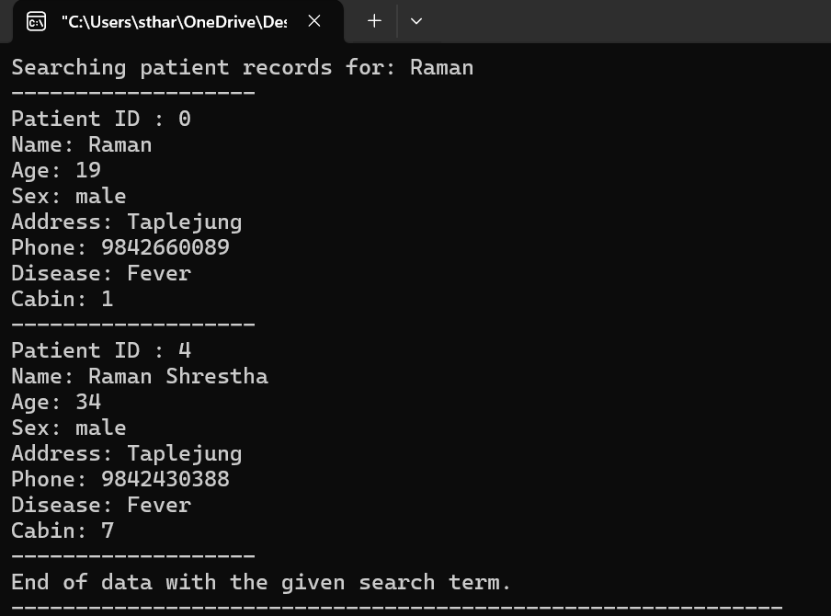

Slide 18
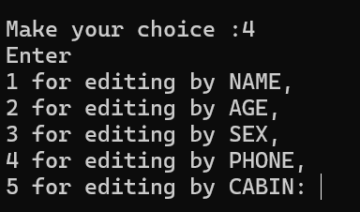
5. For editing information

Slide 19
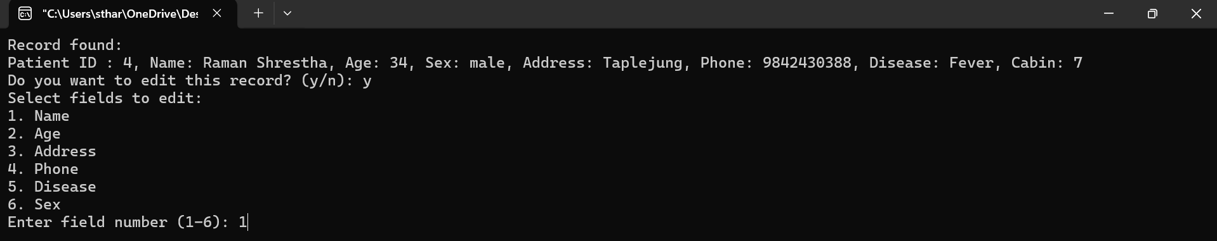
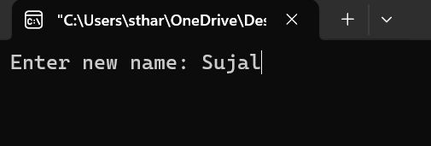

Slide 20
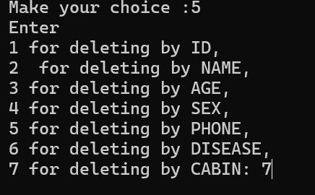
6. For deleting information

Slide 21
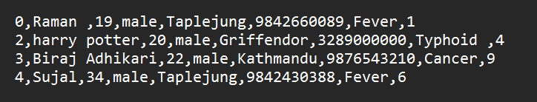
7. Viewing Information in File

Slide 22
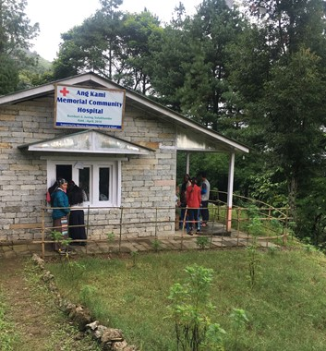

SCOPE AND APPLICATIONS
The software will be used in small to medium scale health posts and other health institutions primarily located in the rural areas of the country in order to yield the maximum benefit.

Slide 23
FUTURE ENHANCEMENT
The current functionalities in this program can be used for basic operations like Adding, Viewing, Searching, Editing, and Deleting the information of the patients.
We plan on adding the following Future Enhancements:
Introduction of Billing System
Allocating Appointments to Doctors
Allocating Day for surgery
Diet Plans and Health Routines
Graphical Interface

Slide 24
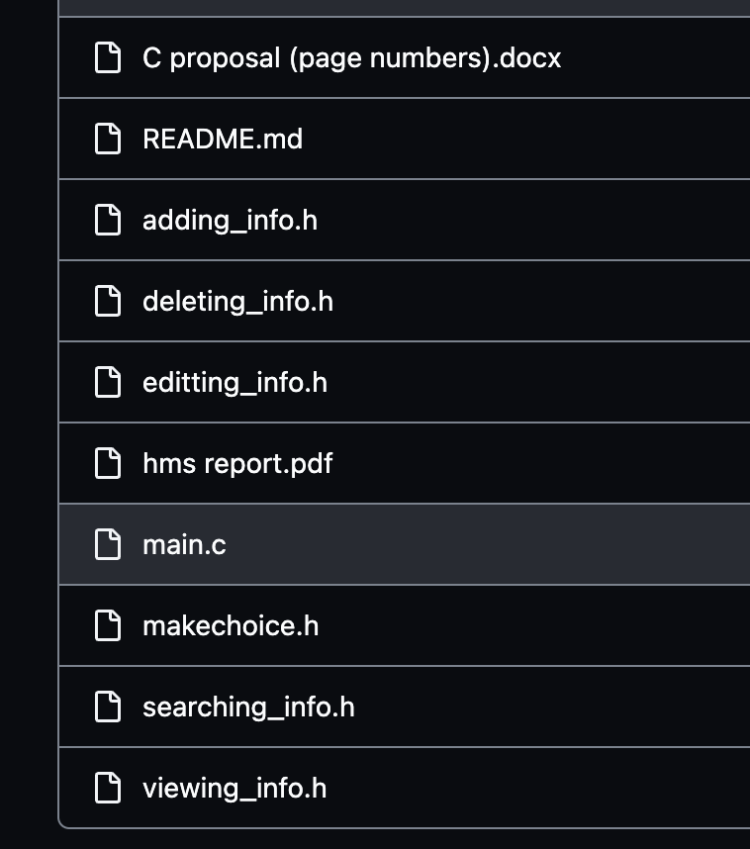
LINK TO ACCESS THE CODE:
https://github.com/shaswat-13/hospital_mgmt_system

Slide 25
THANK YOU!!!

